Slide 1
Task-oriented dialogue & Ontology based state tracking
By: Divye & Victor

Slide 2
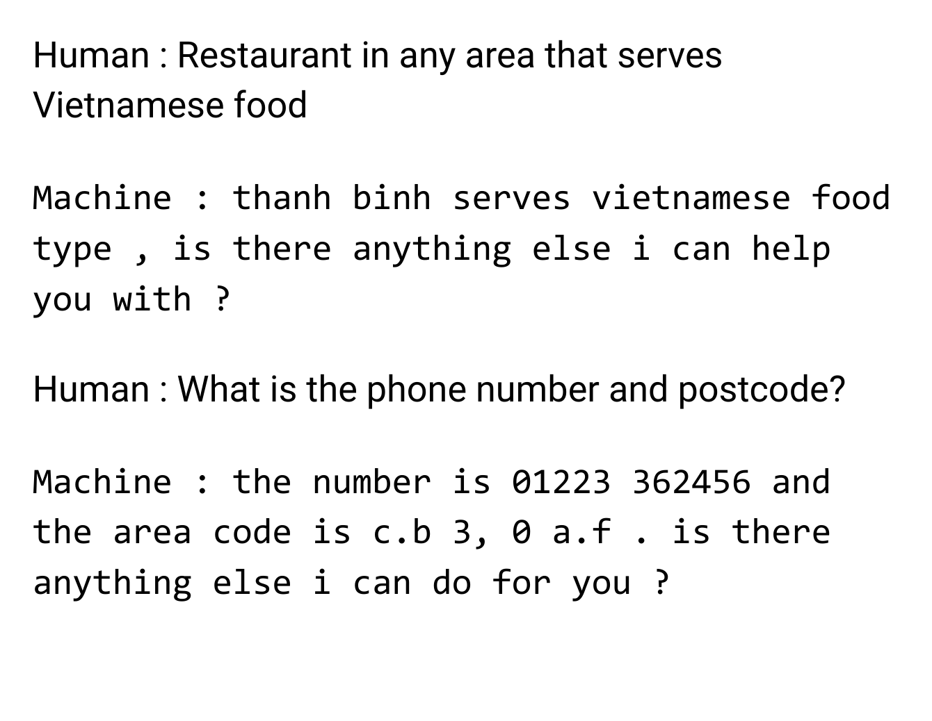

Task-based Spoken dialogue systems (SDS)
Spoken dialogue systems (SDS) allow users to interact with computer applications through conversation
Task-based systems help users achieve goals
For Example: Finding a restaurant

Slide 3
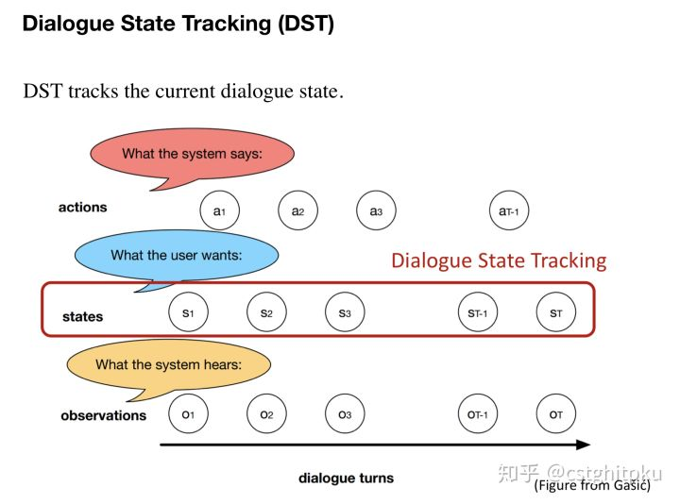
Dialogue State Tracking (DST)
The dialogue state tracking (DST) component of an Spoken dialogue systems (SDS) serves to interpret user input and update the belief state, which is the system’s internal representation of the state of the conversation.

Slide 4
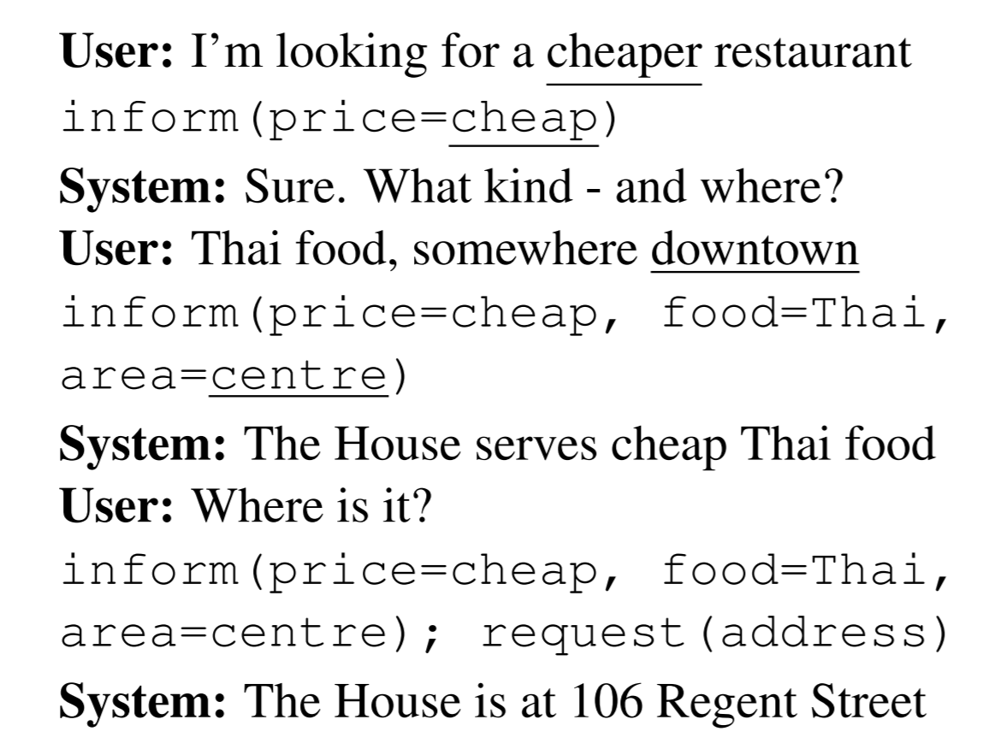
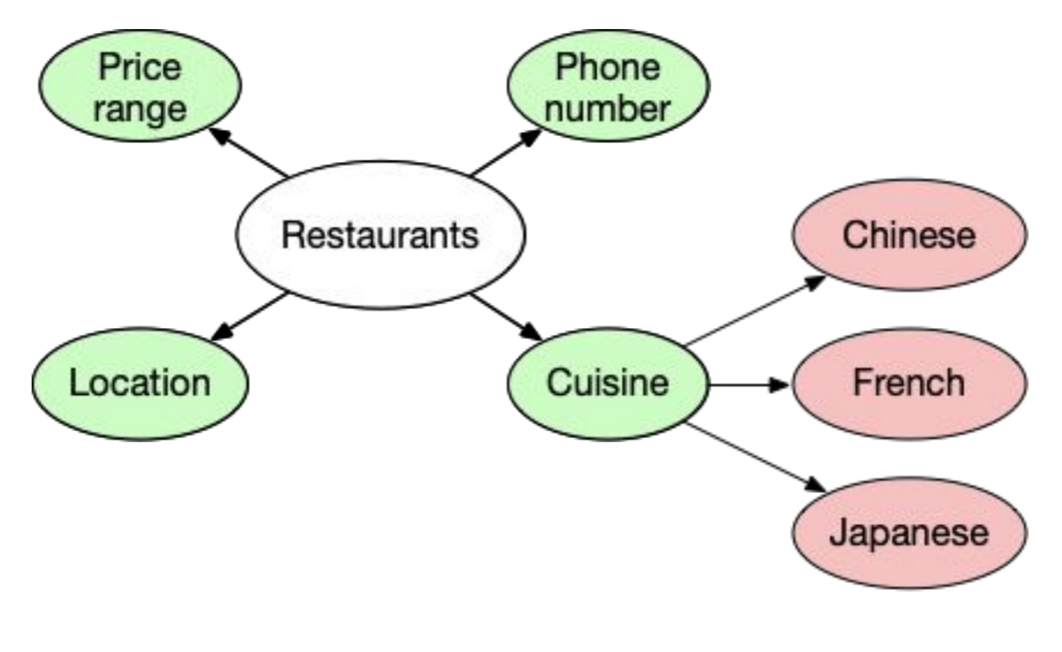
What is a Ontology-based State?
State: Representation of the user’s belief
Collection of slot/value pairs
Slot: Food
Value: Thai
2 types of slots
Informational slots: Search constraints
Example: Inform(Price=Cheap, Food=Thai)
Requestable slots: Questions by the users
Example: Request(address)
Need to define these slot/values
Ontology

Slide 5
Problem
DST: critical component
Scalability/Dealing with complex dialogue domains.
SLU models: large amounts of annotated training data.
Hand-crafted lexicons
Wen et al., 2016
Discussion question: Why do you think?
Notes:
Pre-trained word embeddings weren’t that popular

Slide 6
Older Approaches
Separate SLU and DST
SLU: Detect slot-value pairs from ASR
Binary classification/Sequence model
DST: Update the belief state
Discussion question: Thoughts? Drawbacks?
Joint SLU/DST
Generate belief states from ASR predictions
Relies on delexilization
Replace text with generic labels in the dialogue
Discussion question: Drawbacks?

Slide 7
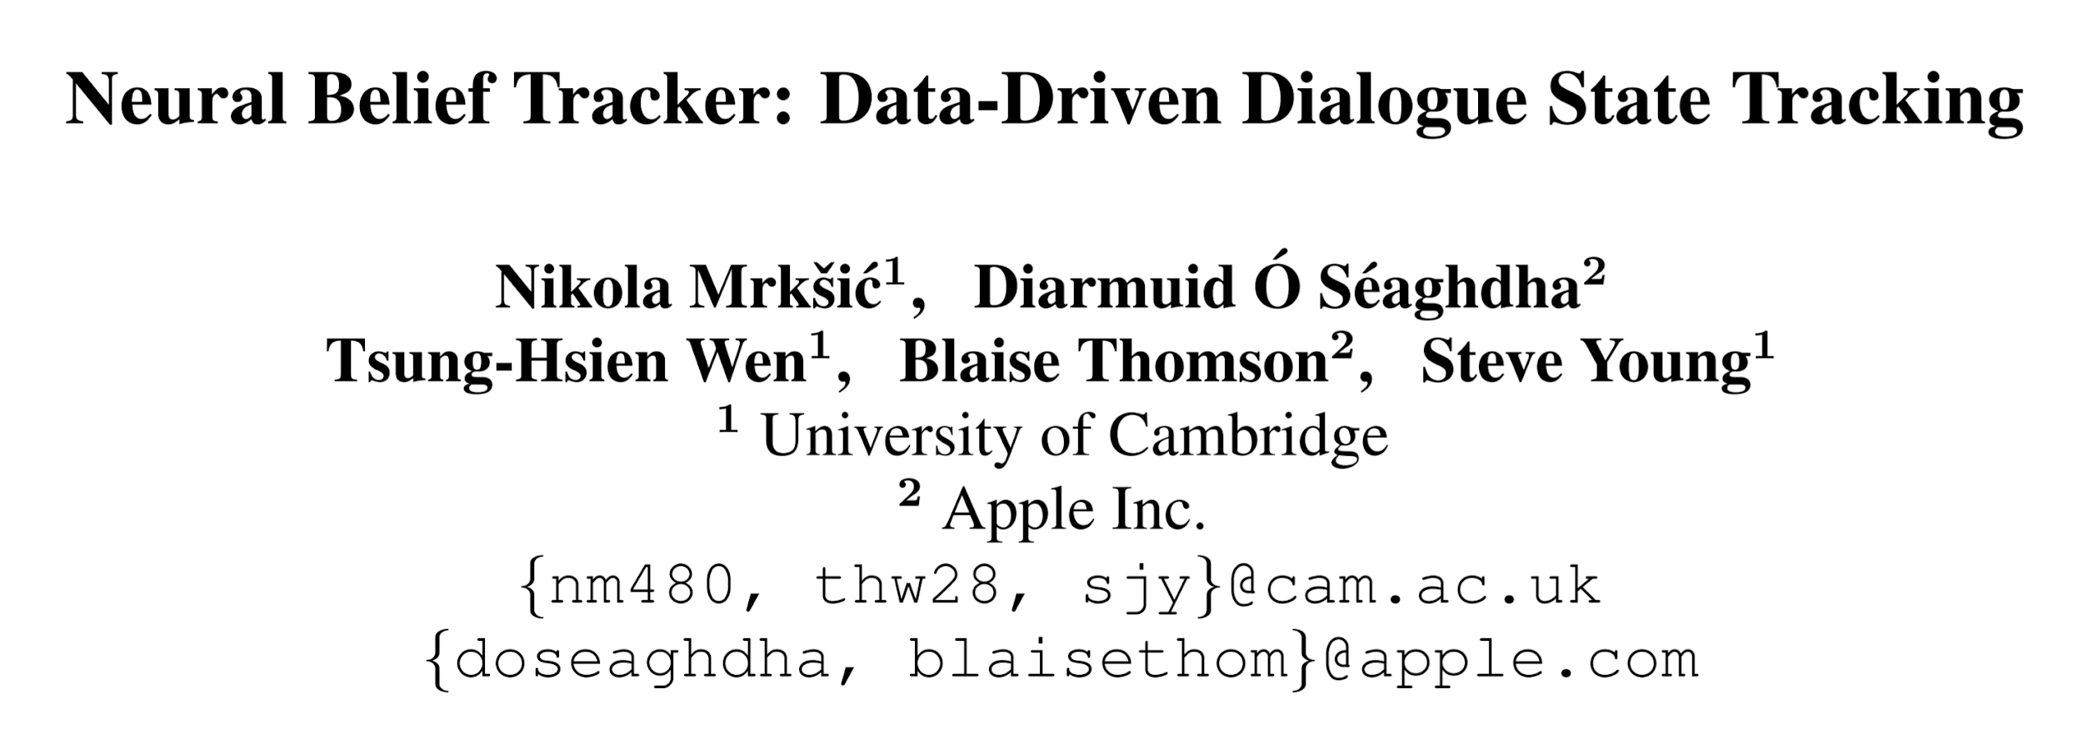

Slide 8

Neural Belief Tracking (NBT)
NBT: Leverages representation learning.
NBT uses pre-trained word vectors
Represent user utterances and dialogue context.
Match performance of SOTA models which rely on hand-crafted semantic lexicons.
DST shifts towards pre-trained word embeddings

Slide 9
Next Topics
Dataset
Models
Experiments

Slide 10
Dataset
Used 2 datasets
Dialog State Tracking Challenge 2 (DSTC2):
The domain is restaurant search
2207 training dialogues and the test set consists of 1117 dialogues
Henderson et al., 2014
Wizard of Oz 2.0 (WoZ2.0):
The domain is restaurant search
1200 dialogues. 600 training, 200 validation and 400 test set
Wen et al., 2017
Notes:
DSTC2: was a challenge: 31 trackers were submitted
WoZ: Similar to DSTC2 with a twist

Slide 11
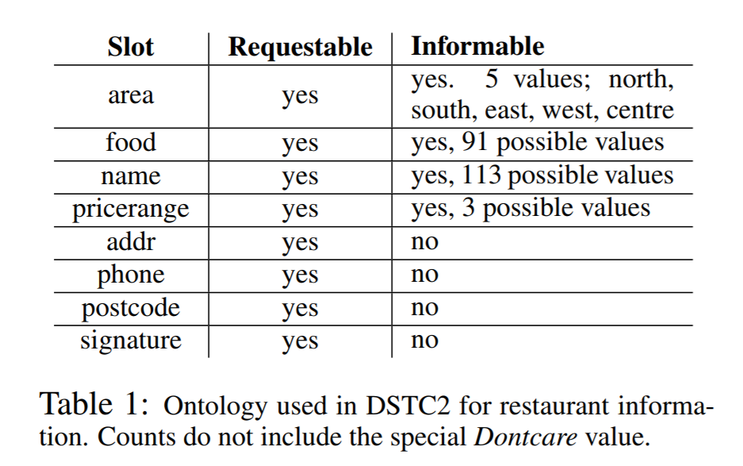
Dialog State Tracking Challenge 2 (DSTC2)
Paid Amazon Mechanical Turkers were assigned tasks and asked to call the dialog systems.
DM-HC: Maintains single top dialog state + handcrafted policy - Train/Dev
DM-POMDPHC: Dynamic Bayesian network + handcrafted policy - Train/Dev
DM-POMDP: DM-POMDPHC + POMDP reinforcement learning - Test
Results from these trackers were manually corrected
Callers were asked to find restaurants that matched particular constraints on the slots area, price range and food.
Notes:
The 3 dialog managers are: • DM-HC, a simple tracker maintaining a single top dialog state, and a hand-crafted policy • DM-POMDPHC, a dynamic Bayesian network for tracking a distribution of dialog states, and a hand-crafted policy • DM-POMDP, the same tracking method as DM-POMDPHC, with a policy learnt using
the users were sometimes asked to find more than one restaurant

Slide 12
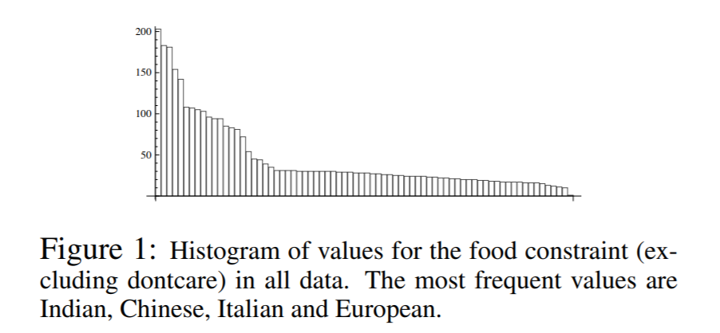
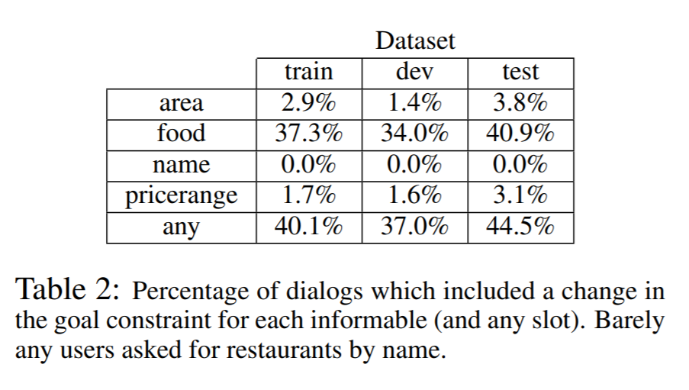
DSTC2 Data Analysis
High WER
26.4% in train
31.9% on dev
28.7% test
Furthermore, the DSTC2 data had to be cleaned: Various spelling errors
Notes:
Degraded: speech recogniser with artificially degraded statistical acoustic models
Good: full speech recogniser optimised for the domain
Batch: Word Confusion Net, improves ASR: In order to provide word confusion networks, ASR was run offline in batch mode on each dialog using similar models as the live system
SLU hypothesis: This paper presents a robust method for SLU based on features extracted from the full posterior distribution of recognition hypotheses encoded in the form of word confusion networks. Following [1], the system uses SVM classifiers operating on n-gram features, trained on unaligned input/output pairs. Performance is evaluated on both an off-line corpus and on-line in a live user trial. It is shown that a statistical discriminative approach to SLU operating on the full posterior ASR output distribution can substantially improve performance both in terms of accuracy and overall dialogue reward. Furthermore, additional gains can be obtained by incorporating features from the previous system output.

Slide 13

Wizard-of-Oz 2.0 (WoZ2.0)
Users: Task similar to DSTC2
Type in natural language sentences to fulfil the task
Amazon Mechanical Turk: The dialogue system
Used DSTC2 ontology.
WOZ focuses on semantic understanding
Not testing robustness to ASR errors.
Notes:
Much cleaner

Slide 14
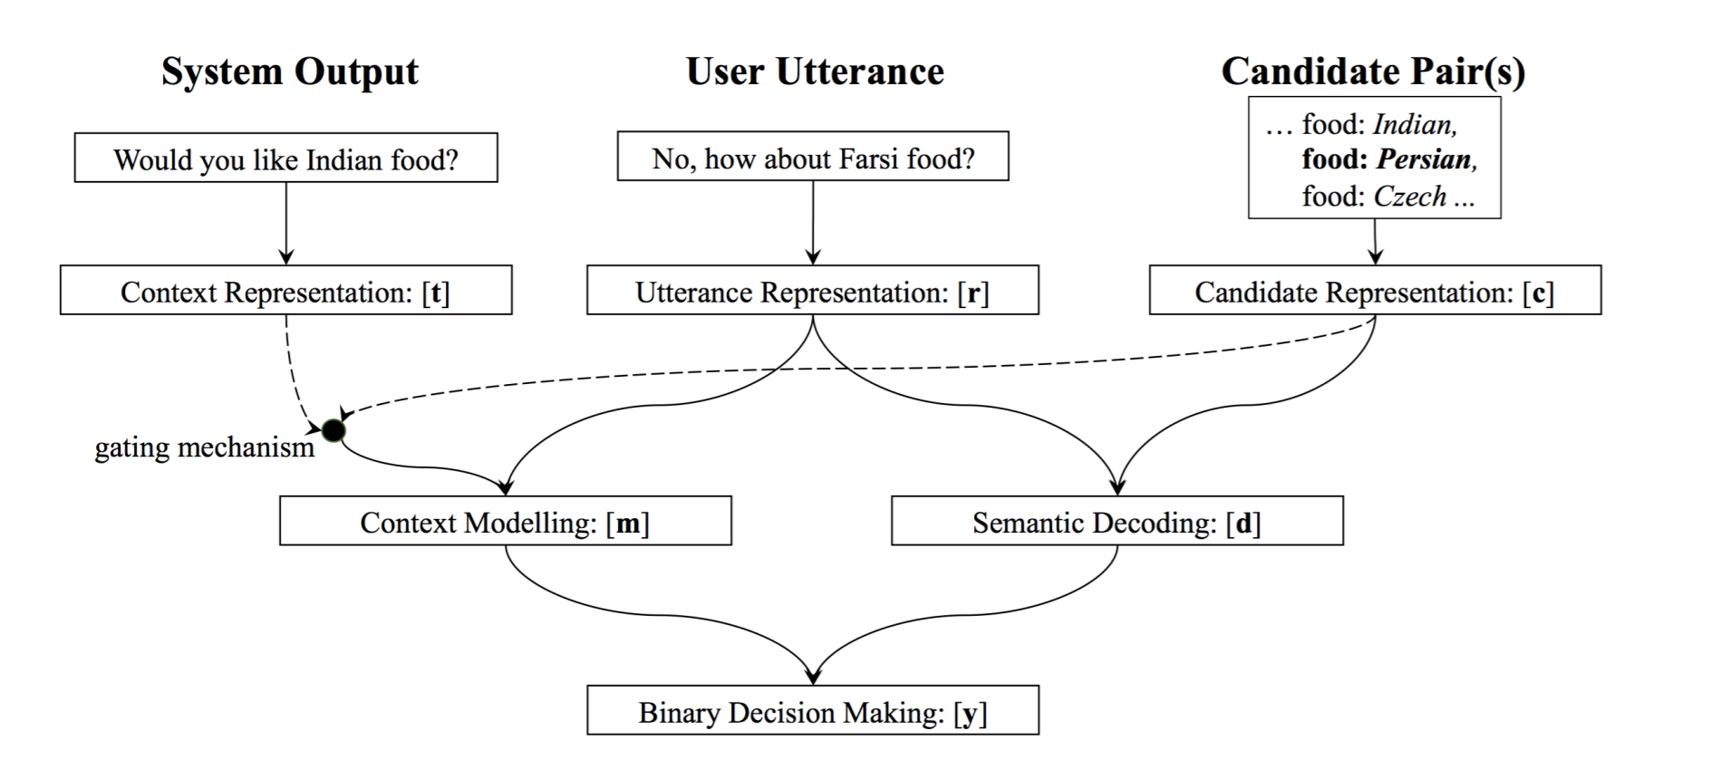
The model
Input:
System dialogue acts preceding the user input
User utterance
A single candidate slot-value pair
Is FOOD=ITALIAN expressed in ‘I’m looking for good pizza’.
Output
Is the slot-value pair is part of the state or not

Slide 15
The model (continued)
Candidate Pair
Representation: Word embeddings of the slot/value names
In case of multiple words: add embeddings
The system dialogue acts (tq, ts, tv)
System Request: tq
System Confirm: (ts, tv)
Representation: Word embeddings of the slot/value names
Notes:
There are 31 places with moderate price range. Can you please tell me what kind of food you would like
I'm sorry, there are no Catalan restaurants. I can provide the phone number and addresses for the asian oriental restaurants

Slide 16
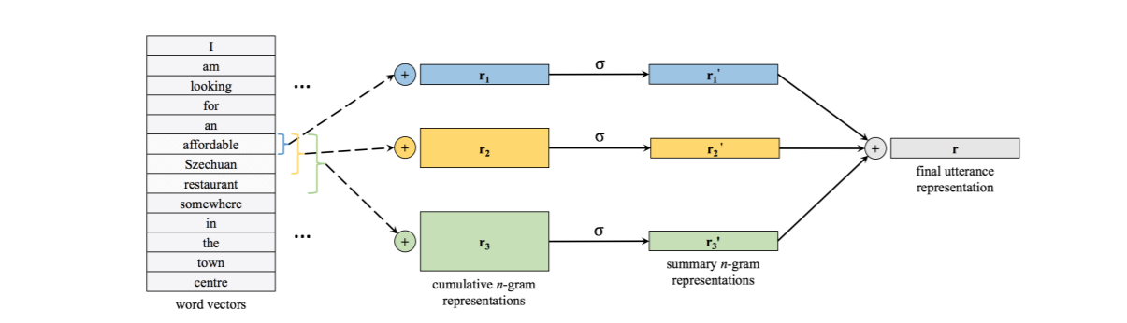
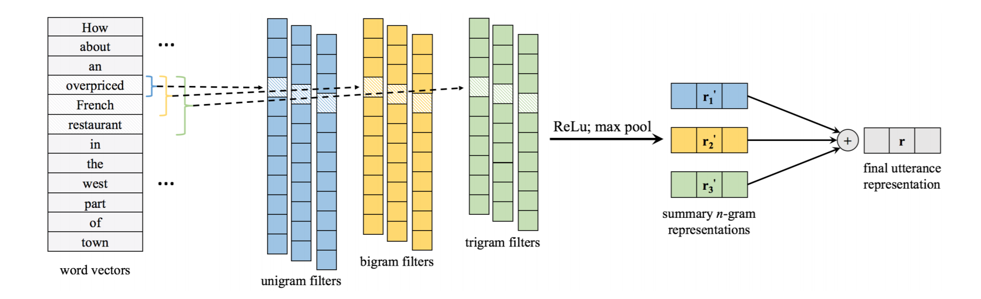
User Utterance Representation
User utterance encoder
They consider 2 models
NBT-DNN
NBT-CNN
Paragram-SL99
Why?
Notes:
Paragram: The Paraphrase Database(PPDB): extensive semantic resource, consisting of a list of phrase pairs with (heuristic) confidence estimates
DNN: Add all uni/bi/tri -> pass through a fully connected layer add them again
CNN: convolution: Filter size of 1, 2, 3 (uni/bi/tri)

Slide 17


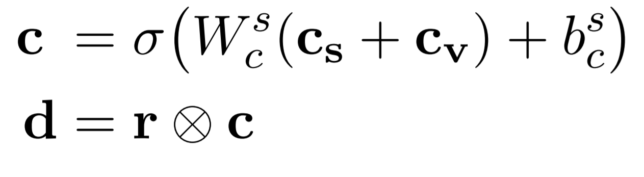

Semantic Decoding
Intent for the current candidate pair
Example: ‘I want Thai food’ with food=Thai
Notes:
The NBT model learns to map this tuple into a single vector c of the same dimensionality as the utterance representation r.
These two representations are then forced to interact in order to learn a similarity metric which:
discriminates between interactions of utterances with slot-value pairs that they either do or do not express
No delexiization required

Slide 18



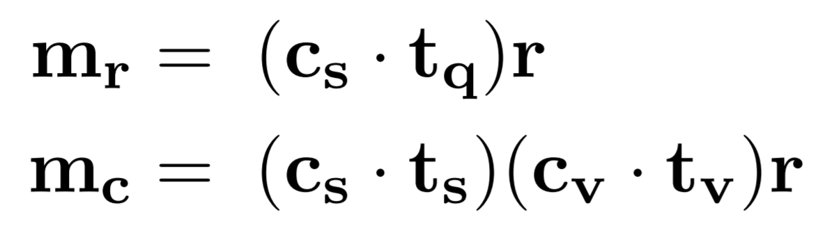
Context Modelling
Encode context of the System
Notes:
The computed similarity terms act as gating mechanisms which only pass the utterance representation through if the system asked about the current candidate slot or slot-value pair.
This type of interaction is particularly useful for the confirm system act: if the system asks the user to confirm, the user is likely not to mention any slot values, but to just respond affirmatively or negatively.
This means that the model must consider the three-way interaction between the utterance, candidate slot-value pair and the slot value pair offered by the system.
If (and only if) the latter two are the same should the model consider the affirmative or negative polarity of the user utterance when making the subsequent binary decisio

Slide 19
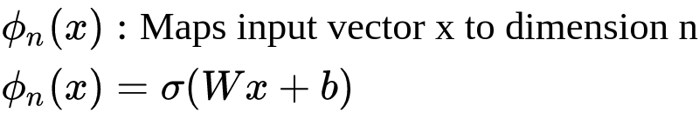
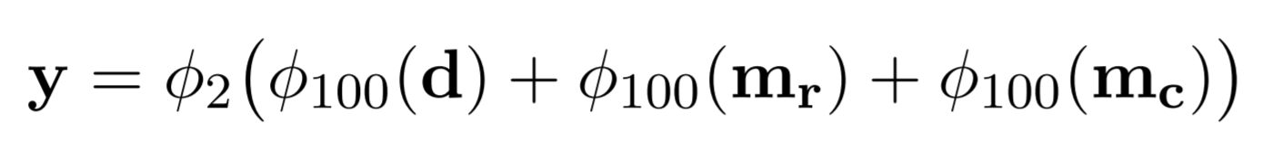
Binary Decision making
Notes:
Final Output layer to combine everything

Slide 20
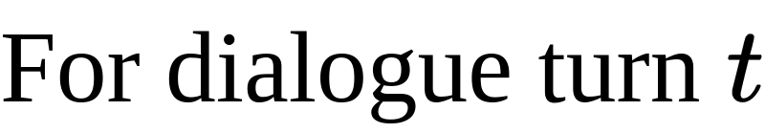
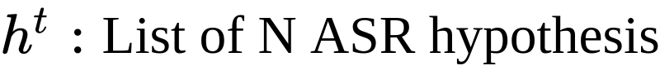
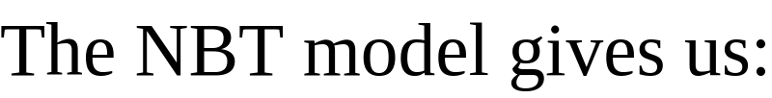
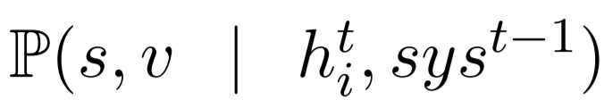
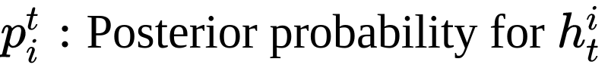



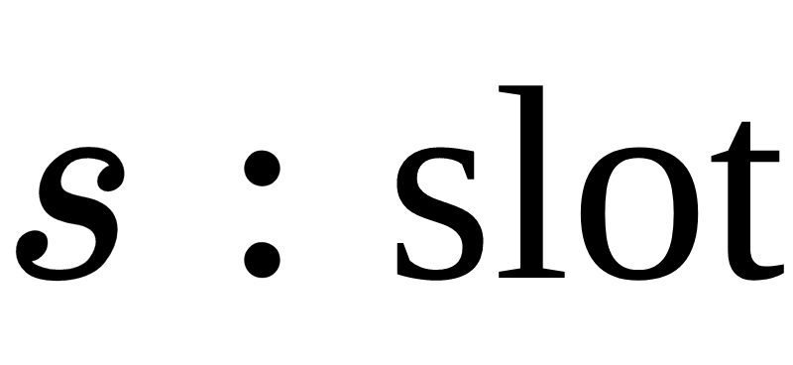
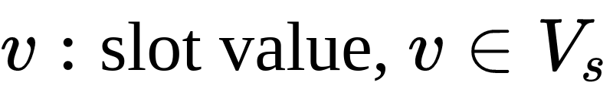
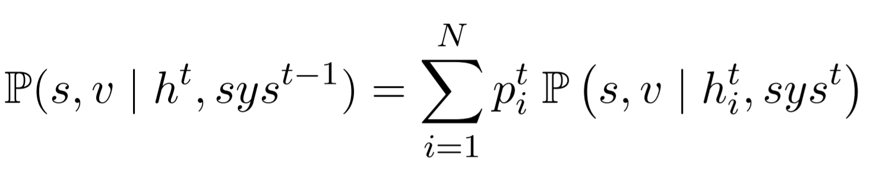
Belief State Update Mechanism
Multiple ASR hypothesis (multiple user utterances): noisy speech recognition
This paper proposes a simple way to deal with that:
Notes:
ASR: Automatic speech recognition

Slide 21
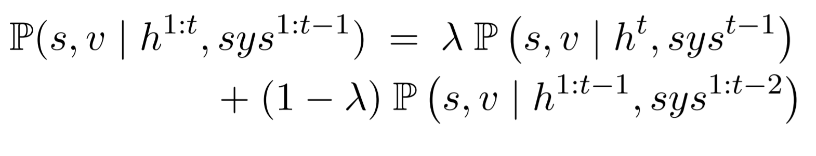
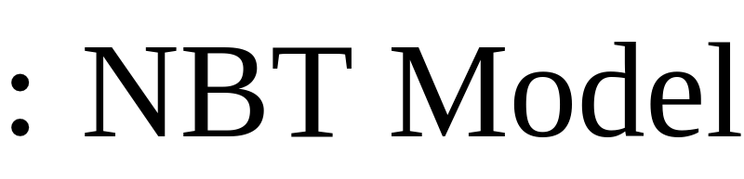

Belief State Update Mechanism
For the final update: need to combined with the (cumulative) belief state up to time (t − 1)
Notes:
ASR: Automatic speech recognition

Slide 22
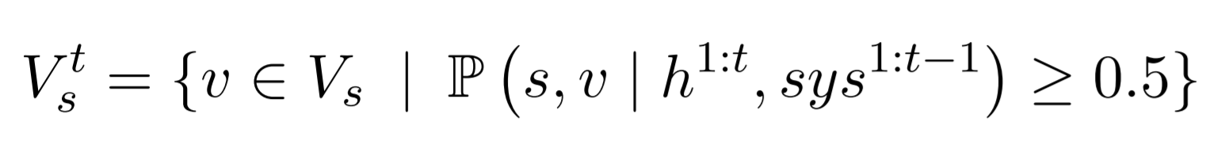
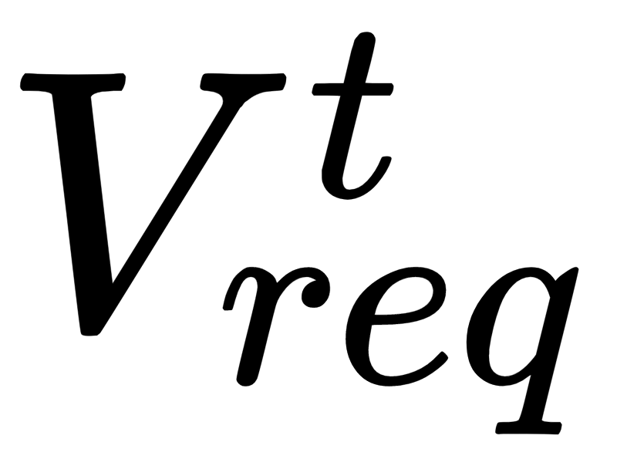
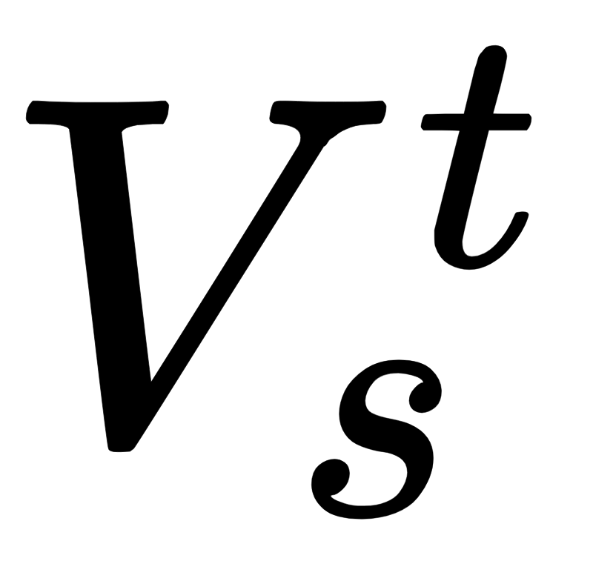
Slot Value Detection
For requests,
all slots in are deemed to have been requested.
Requestable slots: single-turn user queries
For informable (i.e. goal-tracking) slots,
The value with highest probability in
Notes:
ASR: Automatic speech recognition

Slide 23
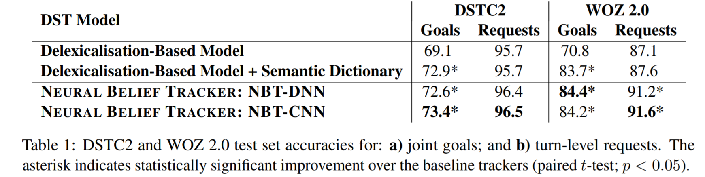
Experiments
Notes:
Explain the joint goal
Turn level requests
Semantic dict: "area": ["area of town","section of the city","side of town","part of town","of town","area","location"]

Slide 24
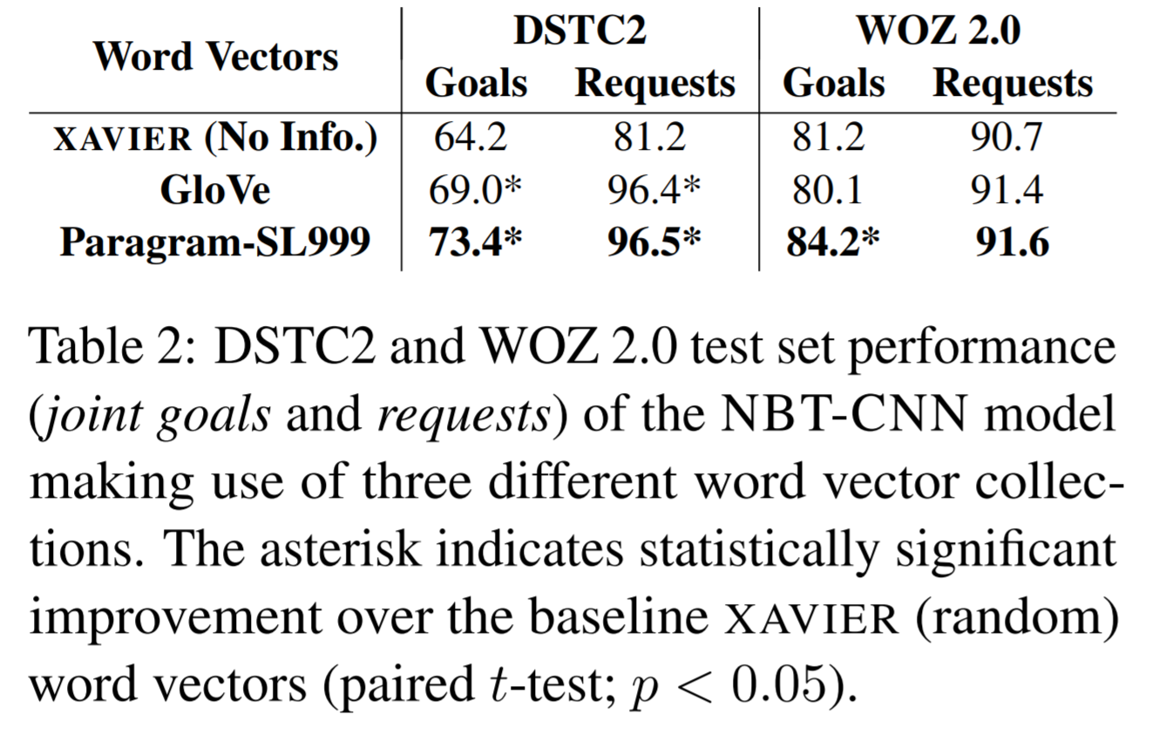
Experiments (continued)
Notes:
We believe this happens because distributional models keep related, yet antonymous words close together (e.g. north and south, expensive and inexpensive), offsetting the useful semantic content embedded in this vector spaces.

Slide 25
Discussion
What do you think about the results?
Why does GloVe perform that bad?
Thoughts on the belief update mechanism?
NBT-CNN vs NBT-DNN?
WoZ2.0 vs DSTC2?
Notes:
Glove: We believe this happens because distributional models keep related, yet antonymous words close together (e.g. north and south, expensive and inexpensive), offsetting the useful semantic content embedded in this vector spaces.

